Slide 1
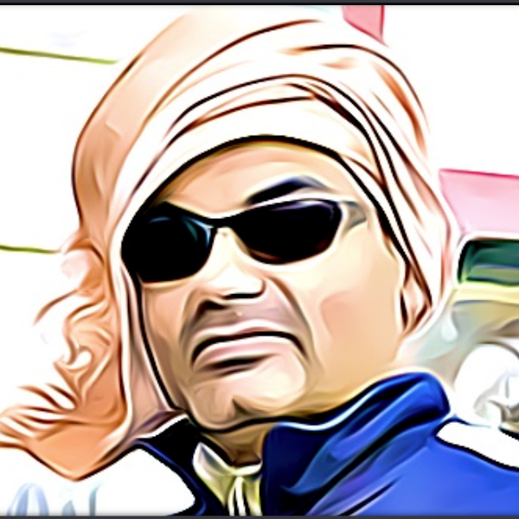
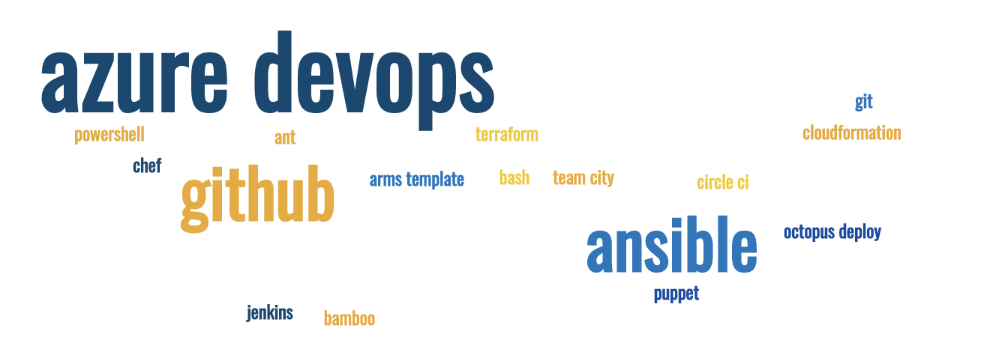
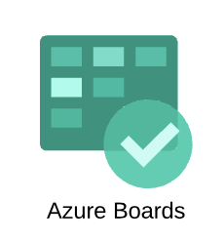
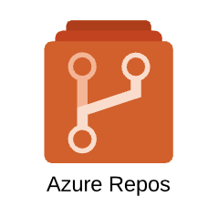
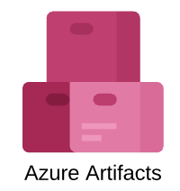

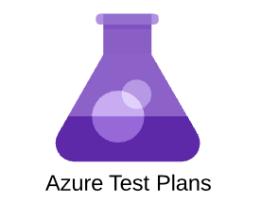
Azure DevOps part 3
Sprint, Backlog, Kanban and Customization
Sujit Singh

Slide 2
Agenda
Azure DevOps – Boards
What we are going to see today
Recap – Azure DevOps
Role Play
Four Users
Developer
Tester
Analyst
Product Owner
Processes
Default
Scrum
Agile
Break and quiz …
Customization

Slide 3
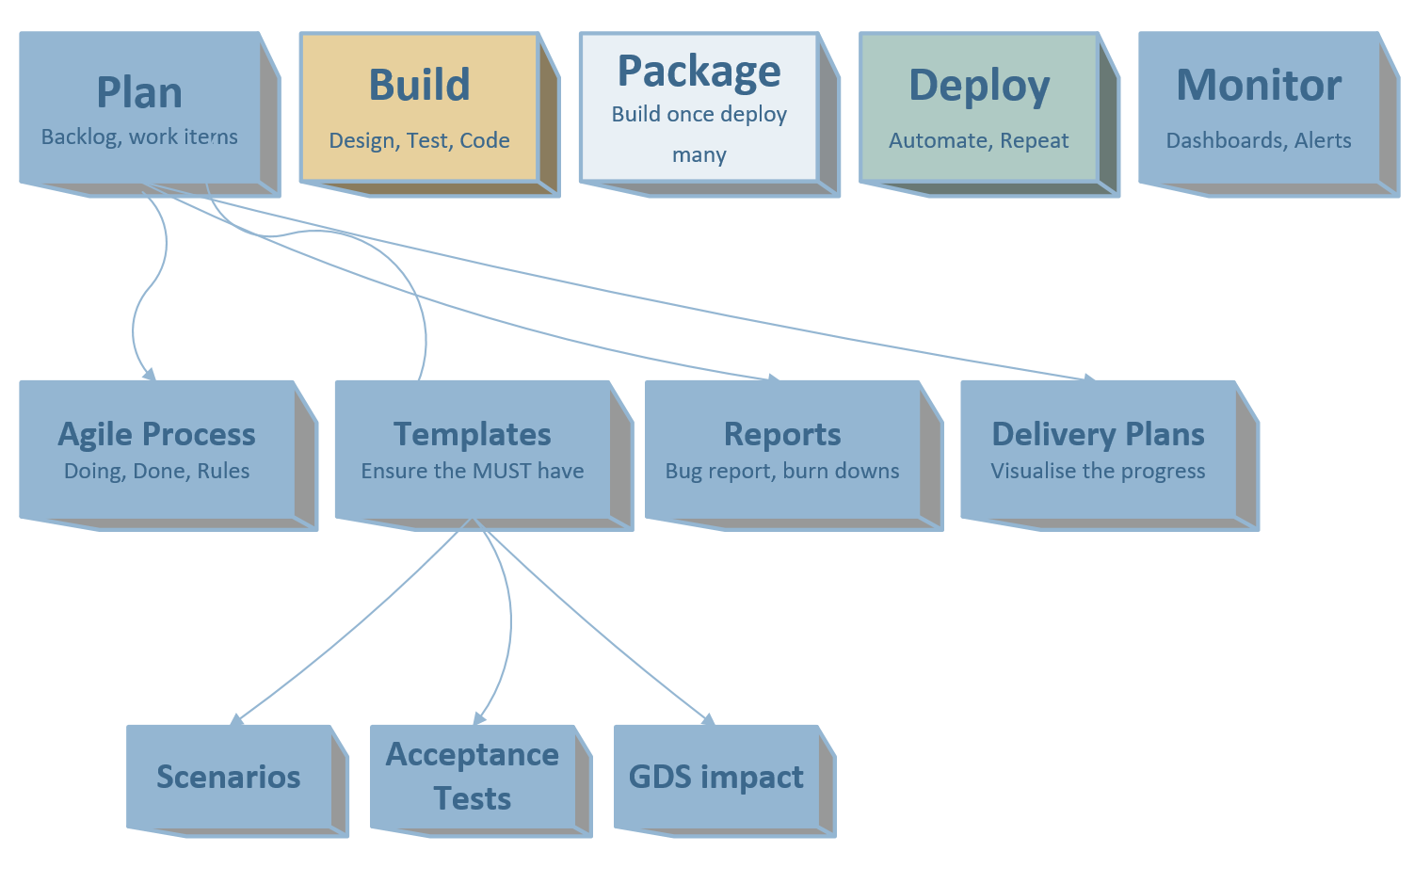
Azure DevOps – Boards (Plan)
Custom Rules

Slide 4
Azure Boards – recap
Free account
Azure Boards,
Azure Repos
Azure Pipeline
Azure Artifacts
Dashboards, Wiki etc

Slide 5
Azure Boards – Role Play
Multiple accounts to pretend different roles
Agile team
Developer
Tester
Analyst
Scrum master
Product owner

Slide 6
Azure Boards – Work items
Processes
Differences between them

Slide 7
Break
Comments

Slide 8
Customization

Slide 9



New
Create User story
Add initial high-level requirement
Ready
Clear Description updated
Acceptance Criteria
Approved
Team agrees and understand implementation requirement
Estimated
Active
Tasks created
Unit testing
Persona and context provided
Implementation done, tasks closed
Documentation done
Resolved
Closed
Verified
Stakeholders informed
Product Owner
Business Analyst
Product Owner
Engineers
Engineers
Product Owner
New stories can be created by other team members (delegated by PO if agreed)
Approval can be done by Scrum master if PO agrees
Story can be closed by Scrum master if PO agrees

